Slide 1

Linking Named Entities in Tweets
with Knowledge Base via User Interest Modeling
2021.10.01.
DongHyun KIM
gmr4rnjs@gmail.com

Slide 2

Contents
Introduction
Preliminaries and Notations
Tweet Entity Linking
Experiments
Related Work and Discussion
Conclusion

Slide 3
Introduction
Tweet Entities
As being free text form, named entity mentions in tweets are potentially ambiguous
The tweet entity linking task is challenging due to the noisy, short, and informal nature of tweets.
practical importance and can be beneficial for various applications of Twitter mining (helpful for the task of user interest discovery)
these context similarity based methods may result in unsatisfactory performance owing to the informal language usage and the limited length of each individual tweet
Aim
To collectively link Twitter user to their mapping entities existing in the knowledge base by leveraging the following two categories of information.
We propose KAURI, a graph-based framework to collectively linK all the nAmed entity mentions in all tweets posted by a user via modeling the UseR’s topics of Interest.

Slide 4
Introduction (Cont.)
Intra-tweet Local Information
The prior probability of the entity being mentioned is high.
The similarity between the context around the entity mention.
In the same tweet, The candidate mapping entity is topically coherent.
A candidate mapping entity in a single tweet is “good” if it has these features.
Inter-tweet User Interest Information
A single tweet may be too short and noisy to provide sufficient context information.
Assume each user has an underlying user’s topics in named entities. If user is likely to be interested in this candidate entity.

Slide 5
Introduction (Cont.)
Contributions
This paper investigate the tweet entity linking task, a new and increasingly important issue due to the proliferation of tweet data and its broad applications.
KAURI is the first framework to collectively link all the named entity mentions in all tweets published by one user with a knowledge base via. Modelling this user’s topics of interest.
KAURI is a novel graph-based framework that unifies two categories of information.

Slide 6
Preliminaries And Notations
Tweet entity linking
A collection of tweets posted by some Twitter user.
Named entity mentions recognized in the given tweets T as input, T are posted by some Twitter user and named entity mention set M.
The goal is to identify the mapping entity e in the knowledge base for each entity mention m in M.
Candidate mapping entity
Identify all the entities that may be referred by m, and denote this as the candidate mapping entity set R for the entity mention m.
To identify R for each m, a dictionary D is need. It contains vast amount of information about various surface forms of entities.
D is a <key, value> mapping, key is a surface forms and value is the set of named entity.

Slide 7
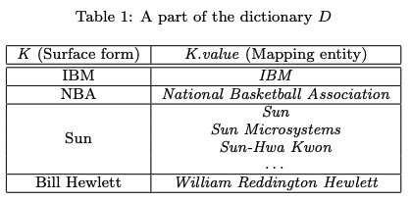
Preliminaries And Notations (Cont.)

Slide 8
Tweet Entity Linking
Assumption
Each Twitter user, each named entity is associated with an interest score, indication the strength of the user’s interest in it.
If some named entity is mentioned by a user in his tweet, that user is likely to be interested in this named entity.
If one named entity is highly topically related to the entities that a user is interested in, that user is likely to be interested in this named entity as well.

Slide 9
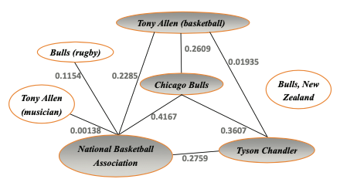
Tweet Entity Linking (Cont.)
Graph construction
G = (V, A, W)
V, Denotes the set of nodes.
A, The set of edges
W : A --> R+, The weight function, assign a positive weight to each edge in A.
The node pair have candidates of the same entity mention, not add and edge.
The edge weight is defined as the topical relatedness. It is calculated using WLM.
Notes:
V, 각 노드는 candidate mapping entity r을 의미, 그리고 이것은 유저의 초기 관심 점수인 p를 지칭하는 관심 점수 s와도 연관이 있다. 이것은 intra-tweet local 정보로 인해 측정된다.
A, 노드 페어 r1,r2가 있을 때, 이 사이의 가중치가 0이 넘는다면 방향성이 없는 간선을 A에 추가.
그리고 두 페어 간 상호의존성의 강도를 나타내는 W에도 추가한다.
엣지 추가 안하는 이유는, 단 하나만이 알맞은 mapping entity이기 때문

Slide 10

Tweet Entity Linking (Cont.)
WLM (Wikipedia Link-based Measure)
Based on the Wikipedia’s hyperlink structure.
U1 and U2 are the sets of Wikipedia articles link to u1 and u2.
W P is the set of all articles in Wikipedia.
If between the true mapping entity and false mapping entity, the topic relatedness is either none or a little weak.

Slide 11
Tweet Entity Linking (Cont.)
Initial Interest Score Estimation
Estimate the initial interest score based on the intra-tweet local information.
Leverage the following three intra-tweet local features.
The prior probability of the candidate entity.
The similarity between the context associated with the candidate entity r.
The topical coherence between candidate entity r and the mapping. entities for the other entity mentions within tweet t.

Slide 12

Tweet Entity Linking (Cont.)
Prior probability
The same surface form m has different popularity, and some entities are very obscure and rare.
Formalize the observation via taking advantage of the count information form Wikipedia. It defined the prior probability Pp.
Context similarity
For calculate Sim(r), compare the context associated with the candidate entity r with the context around the entity mention m in tweet t.
In the Wikipedia page corpus, extract the context of r and preprocess the tweet.
Finally, Measure the cosine similarity of these two vectors weighted by TF-IDF
Notes:
Count®은 entity r을 지목하는 링크와 surface form m을 anchor text의 개수이다.
위키 page corpus에서 각 entity의 존재를 수집하고, r의 words vector로 구성된 짧은 window에서 context를 추출한다.
전처리의 경우, #이나 url 등을 지우는 작업을 한다.

Slide 13

Tweet Entity Linking (Cont.)
Topical coherence
Coh(r) is topical coherence between entities as the topical relatedness between them.
|M| is the number of entity mentions in tweet t, e is the mapping entity for the entity mention m in M.
TR(r, e) is the topical relatedness between the candidate entity r and the mapping entity e for other entity mention m in M.

Slide 14
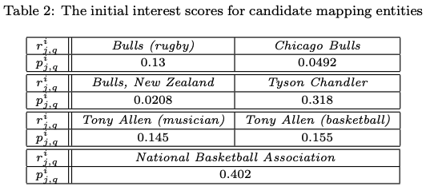
Tweet Entity Linking (Cont.)
Initial interest score
α+β+γ = 1, and α, β and γ are weight factors that give different weights for different feature values in the calculation of initial interest score p.

Slide 15
Experiments
Experimental setting

Slide 16
Related Work
To identify relevant concepts in tweets and generate links
Influential Twitter user identification.
Tweet recommendation.
User interest discovery
Linking named entities in Web documents with knowledge base.
They proposed a graph-based collective entity linking method to model the topical interdependence between entities.

Slide 17
Conclusion
The tweet entity linking task is challenging due to the noisy, short, and informal nature of tweets.
Previous methods focus on linking entities in Web documents, and largely rely on the context around the entity mention and the topical coherence between entities in the document.
This paper propose KAURI, a framework which can effectively link named entity mentions detected in tweets with a knowledge base via user interest modeling.
With experimental results, This paper show that KAURI achieves high performance in terms of both accuracy and efficiency.

Slide 18
Thank you for listening

